Slide 1
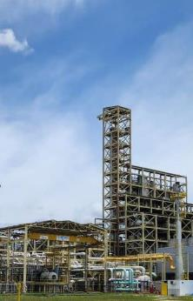
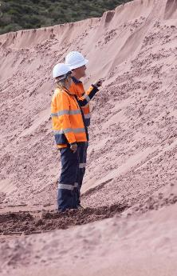

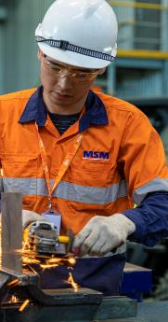
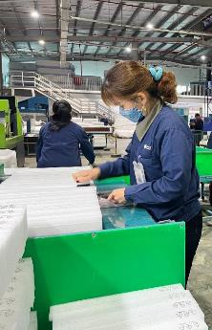
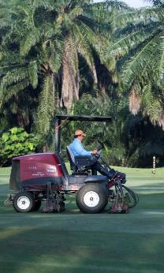
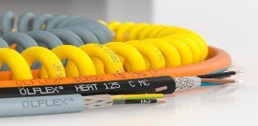
CORPORATE PRESENTATION 2025

Slide 2
CONTENTS
Purpose
Values
Businesses
Management
Sustainability
The Family Enterprise

Slide 3

OUR PURPOSE
We enable sustainable industrial development in ASEAN and beyond.
WHO WE ARE
At Jebsen & Jessen Group, we build upon our distinctive heritage as a trusted provider of quality industrial products and value-added solutions in ASEAN and beyond, with a strong commitment to partner and grow with our customers in a sustainable manner.

Slide 4





OUR VALUES SERVE AS OUR COMPASS…
Trust
Entrepreneurship
Prudence
Commitment
Partnership

Slide 5
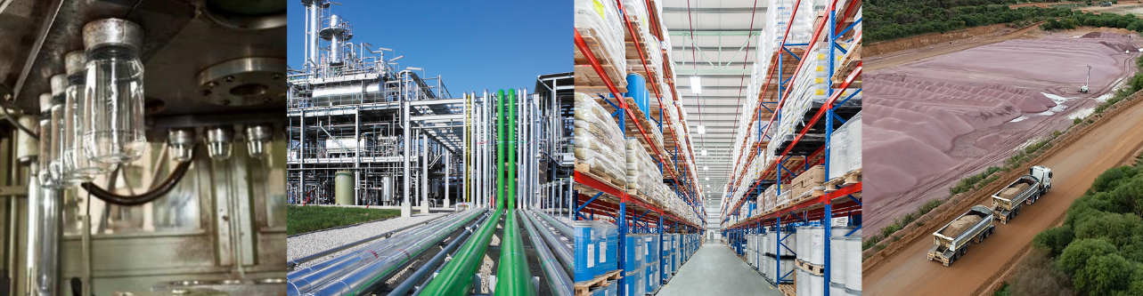
OUR AREAS OF BUSINESS
Manufacturing
Engineering
Distribution
Mining

Slide 6






OUR BUSINESSES
7 BUSINESS UNITS
CONNECTIVITY SOLUTIONS
INDUSTRIAL ENGINEERING
INDUSTRIAL GARNET
INGREDIENTS
MOBILITY, INDUSTRY & BEVERAGE
PACKAGING
TECHNOLOGY
• Cables
• Cable Glands
• Connectors
• Harnessing
• Solar PV Systems
• Methylester (Biodiesel)
• Edible Oil Refining
• Fats Modification
• Oilseed Extraction
• Oleochemicals
• Abrasive Blasting
• Waterjet Cutting
• Coating & Resins
• Feed
• Food
• Performance Chemicals
• Personal Care
• Pharmaceuticals
• Plastics & Rubber
• Automotive
• Beverage
• Industrial
• Bottles & Jars
• Engineered Foam
• Foam Components
• Protective Packaging
• Industrial Services
• Material Handling
• Offshore & Marine Cables
• Pumps
• Turf & Irrigation

Slide 7







GLOBAL PRESENCE
AUSTRALIA
16 countries
BRAZIL
CHINA
GERMANY
>4,000 employees
INDIA
INDONESIA
21 manufacturing, mining and processing facilities
MALAYSIA
MONGOLIA
MYANMAR
SGD 1.6bn turnover
PHILIPPINES
SAUDI ARABIA
SINGAPORE
SGD 1.8bn assets
THAILAND
UNITED ARAB EMIRATES
UNITED STATES
VIETNAM
Notes:
With the acquisition, the numbers will increase substantially:
4,000 employees
50,000 customers

Slide 8


CONNECTIVITY SOLUTIONS
370
people
turnover
Cables
Cable Glands
Connectors
Harnessing
Solar PV Systems
S$200m
Indonesia | Malaysia
Philippines | Singapore
Thailand | Vietnam

Slide 9
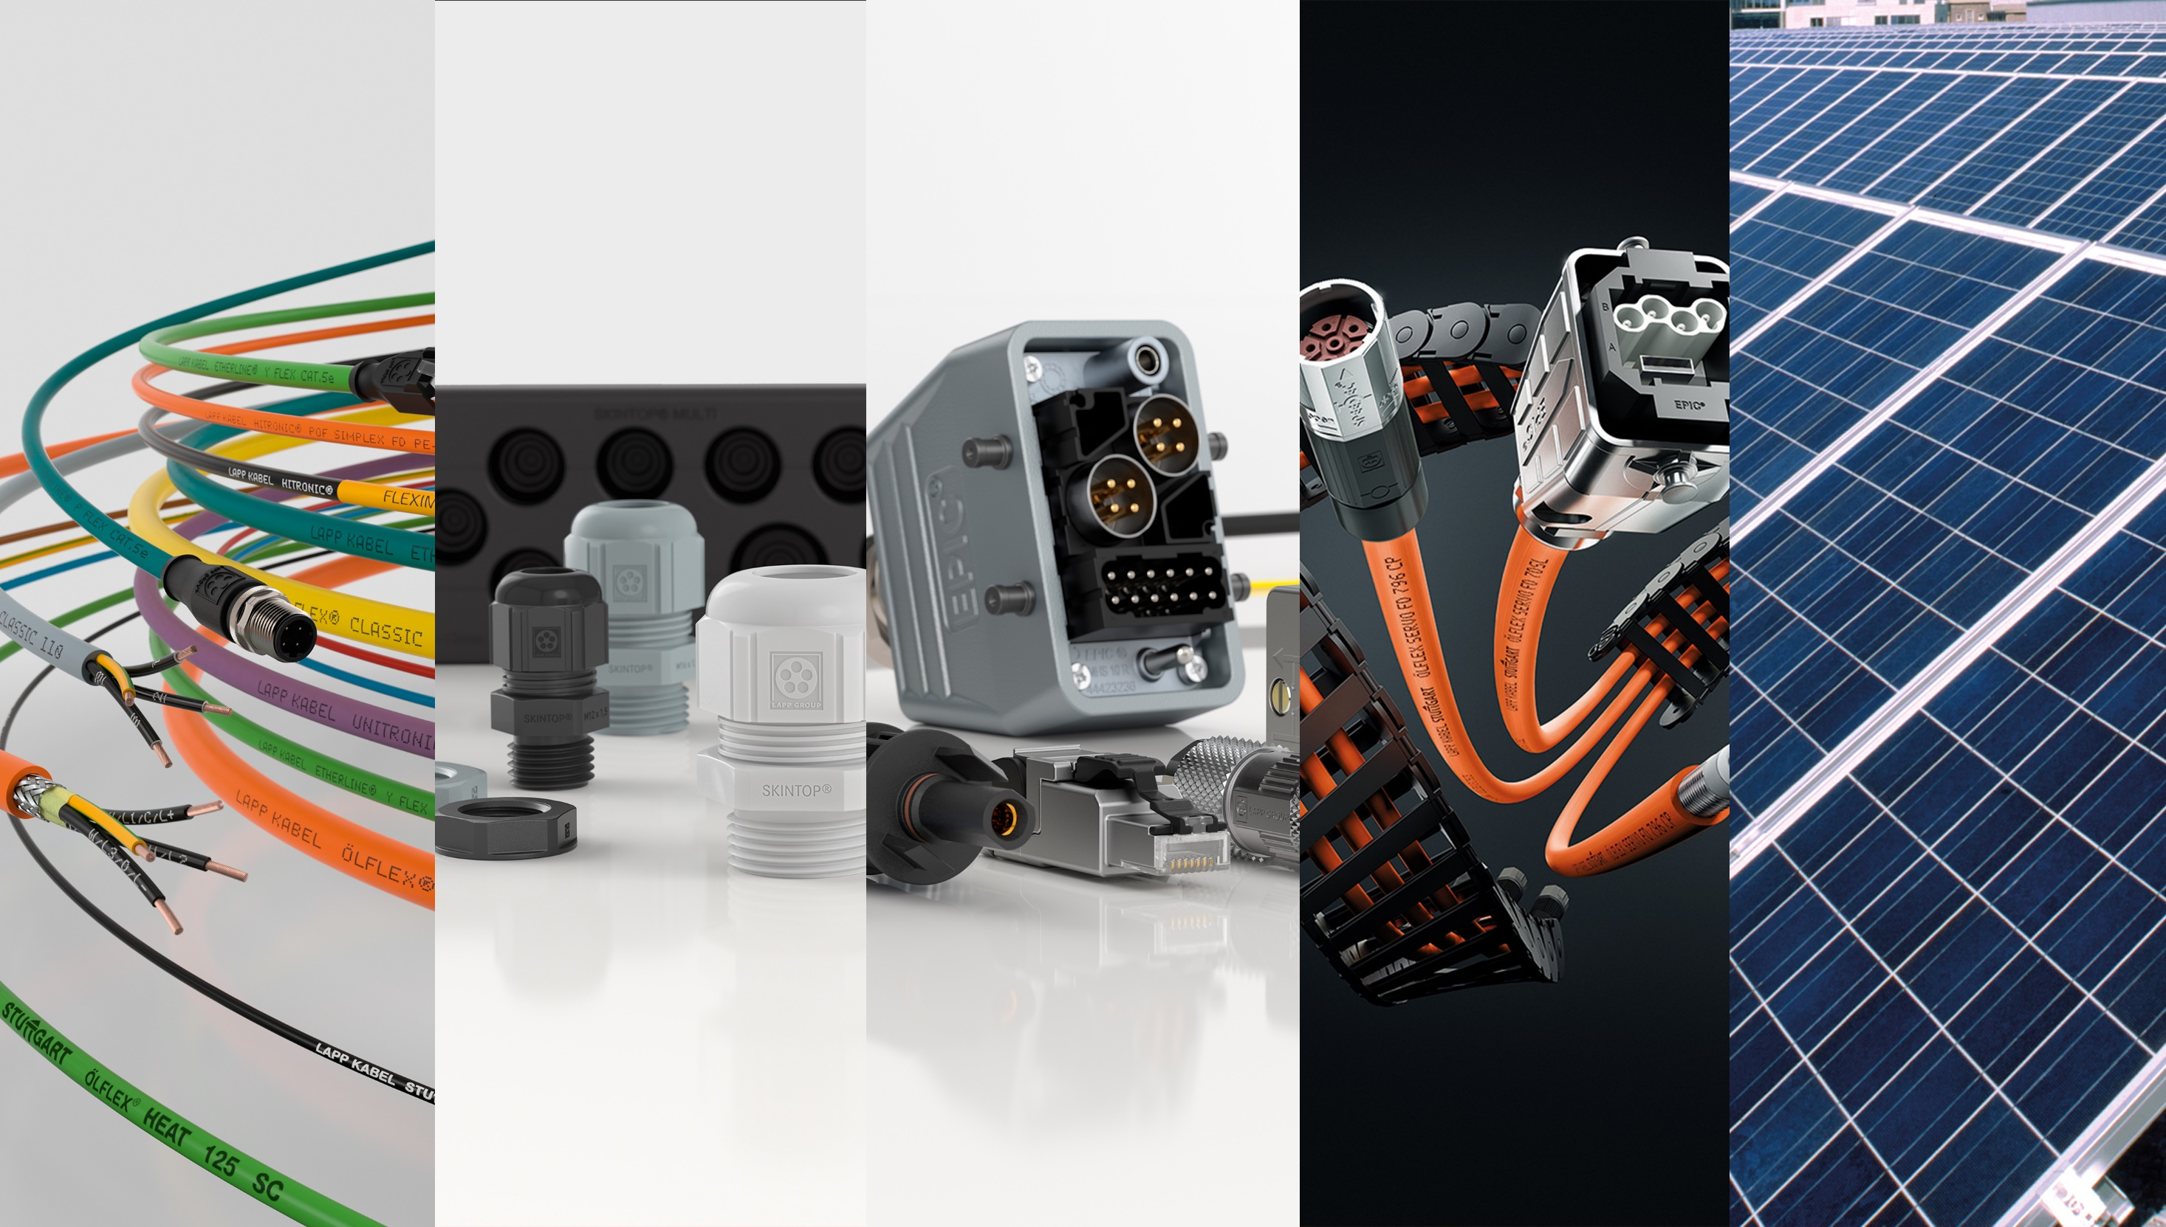
37
people
Indonesia | Malaysia
Philippines | Singapore
Thailand | Vietnam
Cables
Cable Glands
Connectors
Harnessing
Solar PV Systems

Slide 10
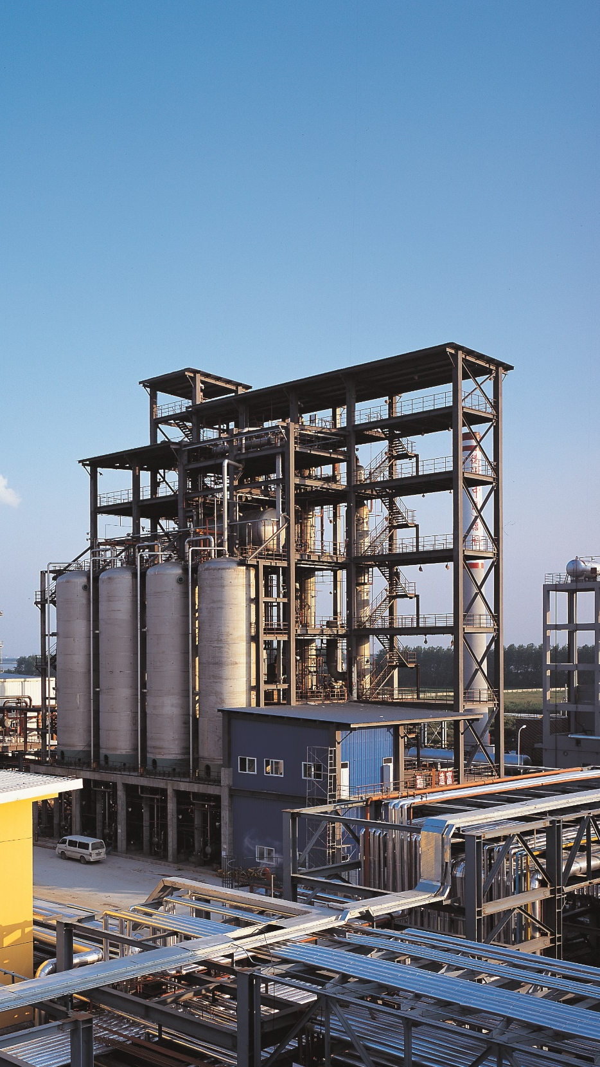

INDUSTRIAL ENGINEERING
170
people
turnover
S$200m
Methylester (Biodiesel)
Edible Oil Refining
Fats Modification
Oilseed Extraction
Oleochemicals
Brazil | China |
Germany | India | Indonesia | Malaysia

Slide 11
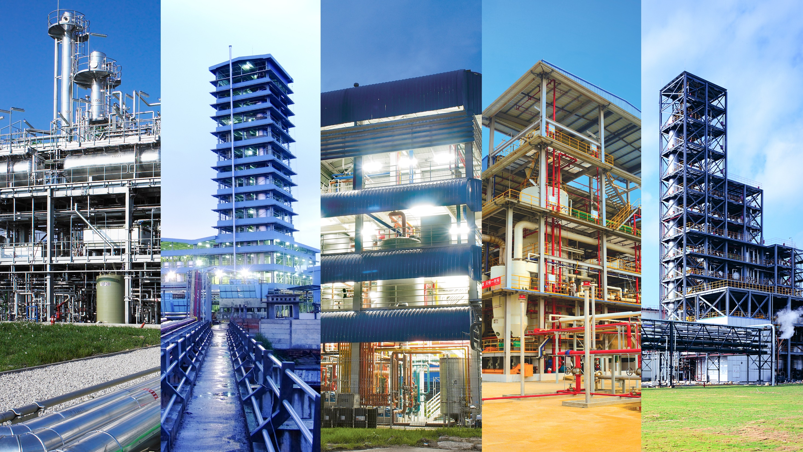
37
people
Indonesia | Malaysia
Philippines | Singapore
Thailand | Vietnam
Methylester (Biodiesel)
Edible Oil Refining
Fats Modification
Oilseed Extraction
Oleochemicals

Slide 12
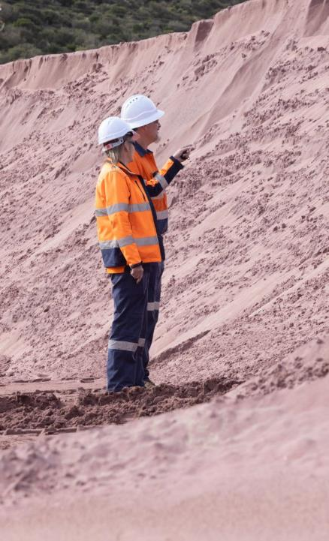
INDUSTRIAL GARNET
450
people
turnover
S$320m
Abrasive Blasting
Waterjet Cutting
Australia | Saudi Arabia | United Arab Emirates | United States

Slide 13
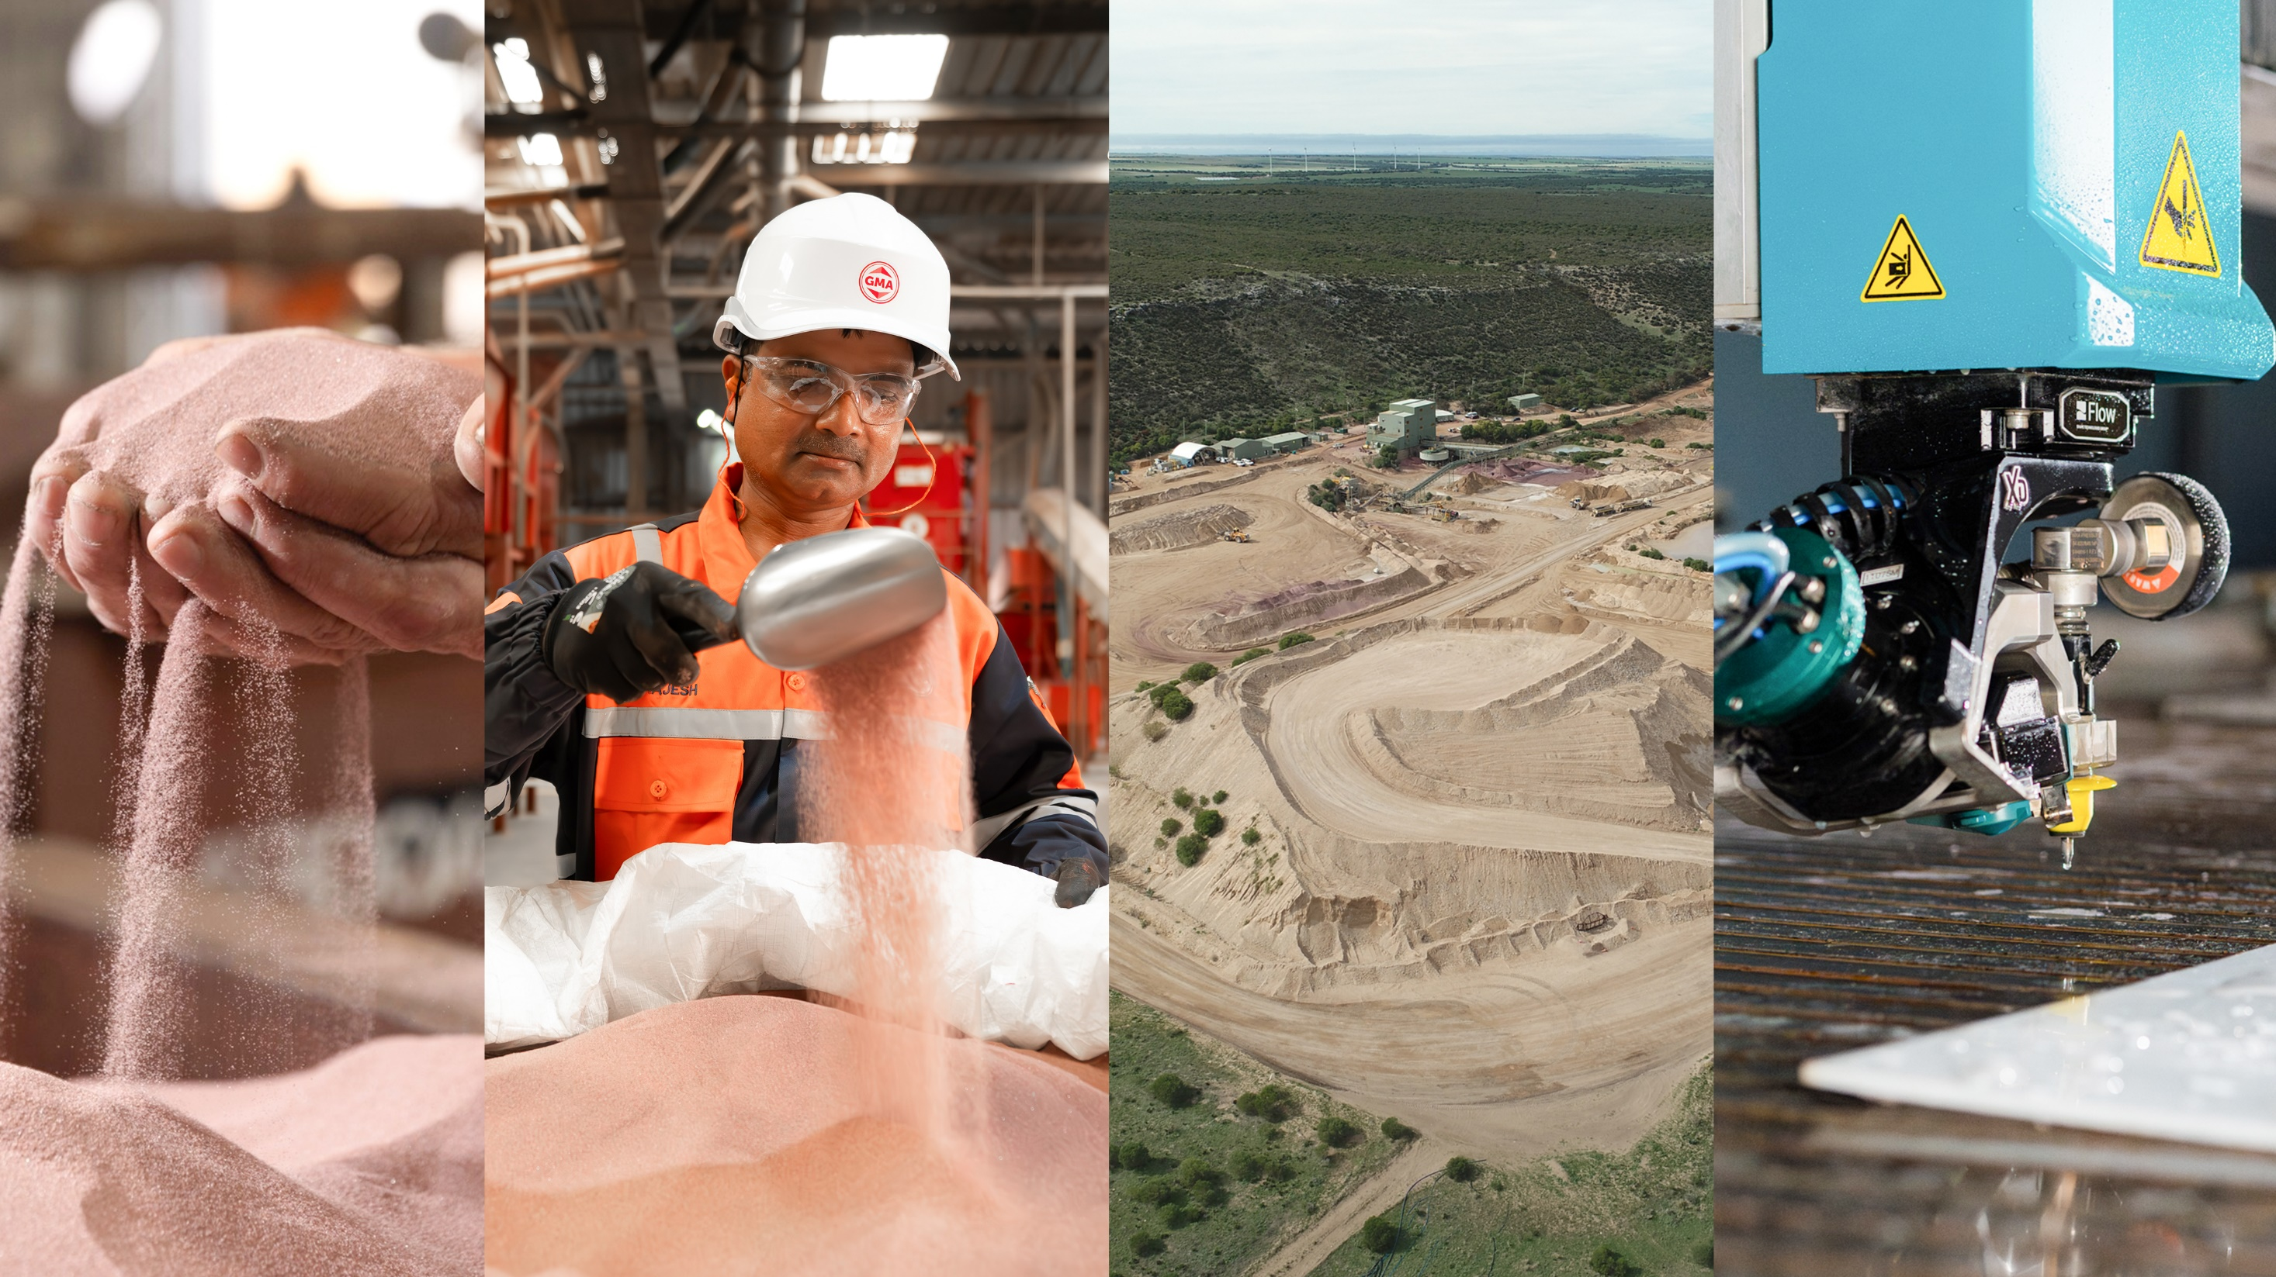
37
people
Indonesia | Malaysia
Philippines | Singapore
Thailand | Vietnam
Abrasive Blasting
Waterjet Cutting

Slide 14

INGREDIENTS
280
people
Coating & Resins
turnover
Feed
S$280m
Food
Performance Chemicals
Indonesia | Malaysia | Myanmar | Philippines | Singapore | Thailand | Vietnam
Personal Care
Pharmaceuticals
Plastics & Rubber

Slide 15

37
people
Indonesia | Malaysia
Philippines | Singapore
Thailand | Vietnam
Coating & Resins
Feed
Food
Performance Chemicals
Personal Care
Pharmaceuticals
Plastics & Rubber

Slide 16

MOBILITY, INDUSTRY & BEVERAGE
710
people
turnover
S$230m
Automotive
Beverage
Industrial
Mongolia

Slide 17

37
people
Indonesia | Malaysia
Philippines | Singapore
Thailand | Vietnam
Automotive
Beverage
Industrial

Slide 18

PACKAGING
1,350
people
Bottles & Jars
turnover
Engineered Foam
Foam Components
S$130m
Protective Packaging
Indonesia | Malaysia | Singapore | Vietnam

Slide 19

37
people
Indonesia | Malaysia
Philippines | Singapore
Thailand | Vietnam
Bottles & Jars
Engineered Foam
Foam Components
Protective Packaging

Slide 20

TECHNOLOGY
800
people
Industrial Services
Material Handling
Offshore & Marine Cables
Pumps
Turf & Irrigation
turnover
S$240m
Australia | China |
Indonesia | Malaysia | Myanmar | Philippines | Singapore | Thailand | Vietnam

Slide 21

37
people
Indonesia | Malaysia
Philippines | Singapore
Thailand | Vietnam
Industrial Services
Material Handling
Offshore & Marine Cables
Pumps
Turf & Irrigation

Slide 22
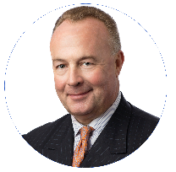
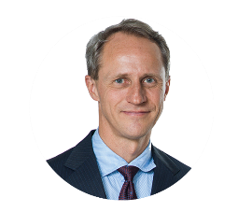
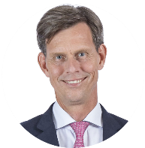
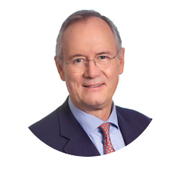
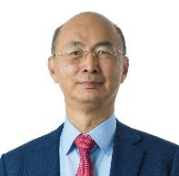
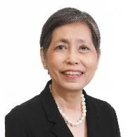
BOARD OF DIRECTORS
Hans Michael Jebsen
Chairman
Jebsen & Co
Heinrich Jessen
Chairman
Jebsen & Jessen
Per Magnusson
Group CEO
Jebsen & Jessen
Fritz Graf von der Schulenburg
Managing Partner
Jebsen & Jessen Hamburg
Chui Tau Siong
Director
Jebsen & Jessen
Euleen Goh
Director
Jebsen & Jessen

Slide 23
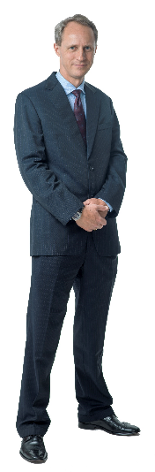
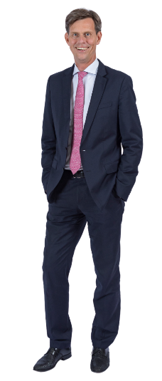
EXECUTIVE BOARD
Heinrich Jessen
Chairman
Jebsen & Jessen
Per Magnusson
Group CEO
Jebsen & Jessen

Slide 24
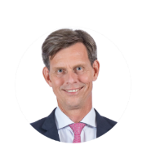


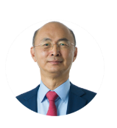



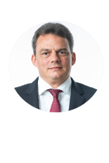


EXECUTIVE MANAGEMENT TEAM
Heinrich Jessen
Chairman
Jebsen & Jessen
Per Magnusson
Group CEO, Jebsen & Jessen
CEO, Technology
Lim
Siew Tin
CEO
Ingredients
Chui
Tau Siong
CEO
Packaging
Marc von Grabowski
CEO
Connectivity Solutions
Martin Overgaard Hansen
CEO
Industrial Engineering
Grant Cox
CEO
Industrial Garnet
Mark Gabel
CEO
Mobility, Industry & Beverage
Viktor Leendertz
CFO
Jebsen & Jessen
Olivia
Chua
CHRO
Jebsen & Jessen

Slide 25
CORPORATE TEAM
Executive Board
Chief Human Resources Officer
Chief Financial Officer
Corp Comms & Employee Experience
Group ITC
Group Finance & Treasury
Group Corporate & Legal Affairs
The HUB
Group Audit & Taxation
Rewards
Development
Credit & Cash Management
Talent
IT Support & Admin
Account to Reporting
Country HR Teams
Network Support & Admin
SAP Support

Slide 26

SUSTAINABILITY

Slide 27
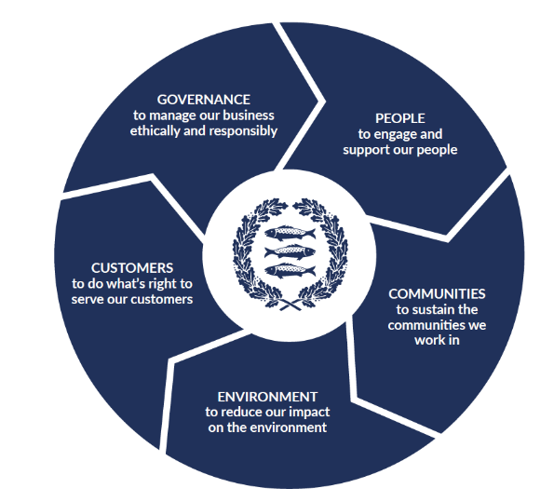


SUSTAINABILITY SNAPSHOT
In 1995, our ‘Environment, Health & Safety’ (EHS) department was implemented for the whole group.
In 2001, it became mandatory for every company to be certified to the globally-recognised ISO14001 and ISO45001 standards.
In 2011, we became the first industrial company in South East Asia to become carbon neutral.
In 2022, we published our first Sustainability Report:

Slide 28

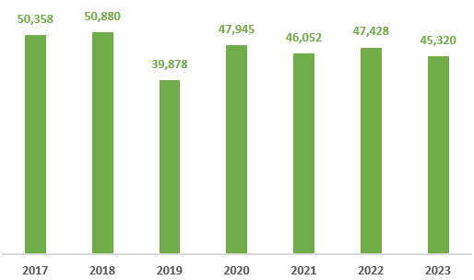
CARBON NEUTRALITY PROGRAMME
We have offset over 640,000 tonnes of CO2 emissions since 2011
Various emission reduction initiatives including:
  Solar panels on manufacturing facilities
  Substitution of fossil fuels through renewables
We continue to actively seek innovative solutions to reduce our environmental impact

Slide 29
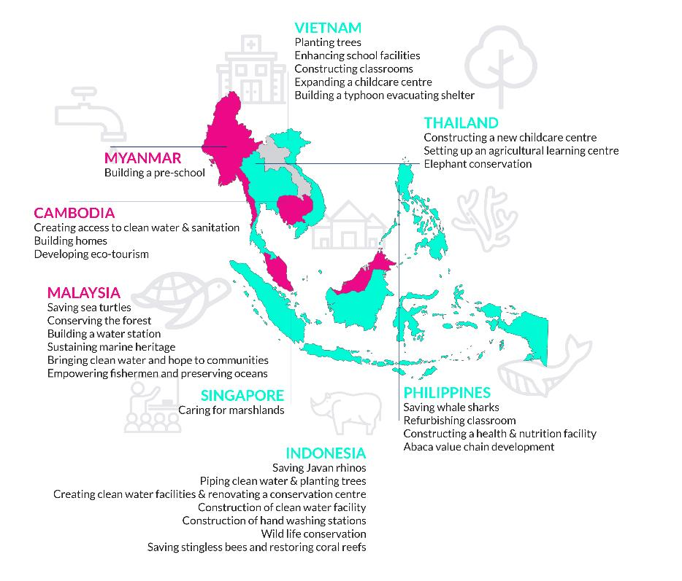
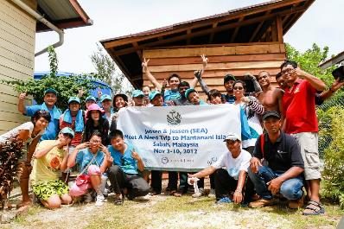

SOCIAL RESPONSIBILITY
‘Meet a Need’ Programme
  Combines corporate volunteering with funding for projects that meet specific social or environmental needs in the ASEAN region
  500+ employees since 2007
  25,000+ hours spent volunteering
  >30 communities
  SGD 6 million+ invested by Jebsen & Jessen

Slide 30
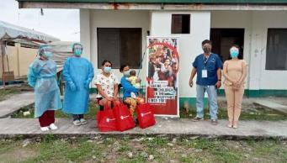
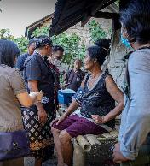
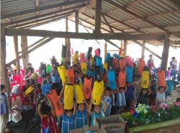
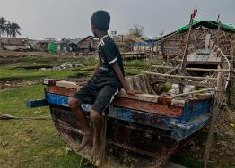


DISASTER RESPONSE
‘Save the Children’ Partnership
  Provides critical support and funding to communities affected by disasters in the ASEAN region
  1,000+ people helped since 2020
  Emergency relief goes to improving mental health, increasing access to COVID-19 vaccines and providing essential supplies to displaced children
Making a difference in the lives of children in disaster-stricken areas of countries like Philippines, Indonesia and Myanmar.

Slide 31
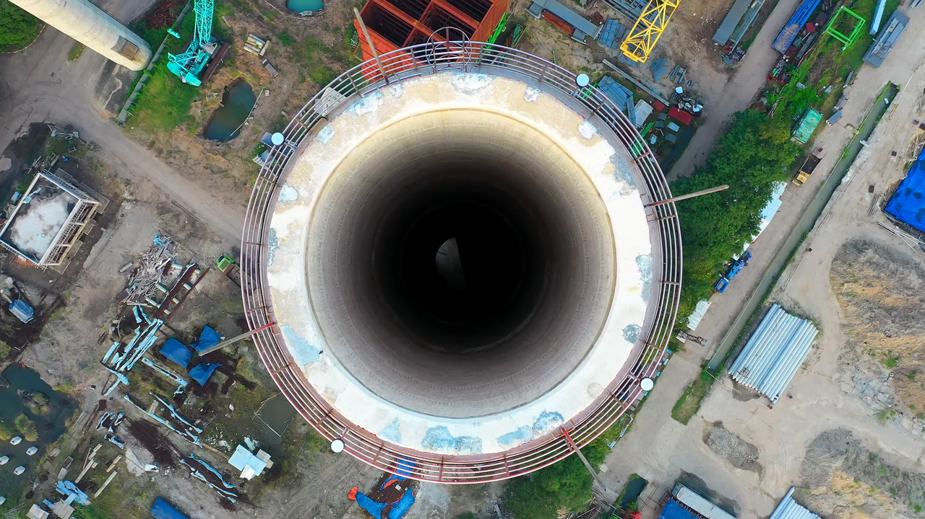
THE
FAMILY ENTERPRISE
Over 125 years of history
THE
FAMILY ENTERPRISE
Over 125 years of history

Slide 32




THE FAMILY ENTERPRISE
Jebsen & Jessen Group
Jebsen & Jessen Hamburg Group
Connectivity Solutions • Industrial Engineering • Industrial Garnet Ingredients • Mobility, Industry & Beverage • Packaging • Technology
Australia | Brazil | China | Germany | India | Indonesia | Malaysia | Myanmar | Mongolia | Philippines | Saudi Arabia | Singapore | Thailand | UAE | USA | Vietnam
Chemicals • Garnet • Industrial Services • Textiles
Canada | Colombia | Denmark | Ecuador | France | Germany | Panama | Switzerland | United Kingdom | USA
Jebsen Group
Triton Textile Group
Consumer • Beverage • Motors • Logistics • Capital
Mainland China | Hong Kong | Macau
Textiles
Bangladesh | Mainland China | Hong Kong
6,000
26
US$ 2.4bn
US$ 4.0bn
people
countries
assets
turnover

Slide 33





GET CONNECTED
Subscribe to ‘The Mackerel’
Follow us!
Jebsen & Jessen Group
@we.are.jj
We are Jebsen & Jessen

Slide 34
THANK YOU

